Slide 1
Chapter 10: Formal methods and SysML
Prof. E.B.Fernandez

Slide 2
Secure Systems Reserch Group Talk Wednesday, March 29, EE405, 2:00-3:30
“Towards a Security Reference Architecture for Cyber-Physical Systems”,
Virginia Romero
Abstract–Cyber Physical Systems (CPS) are physical entities whose operations are monitored, coordinated, controlled and integrated by a computing and communication core. Security for these systems requires solutions that are robust to threats, especially when securing critical infrastructures. Secure systems need to be built in a systematic way, where security and safety are not just add-ons or built in a piece-meal fashion but are able to handle their complexity in a safe and secure holistic way. All lifecycle stages and all architecture levels need to be considered. The only way to provide this unification in the presence of a myriad of implementation details of the component units, is to use abstraction. In particular, we can apply abstraction through the use of patterns and Reference Architectures (RA). The use of Reference Architectures and patterns is a powerful way to organize and describe security and other non-functional aspects and they have the potential to unify the design of the computational, communication, and control aspects of CPSs. In this talk we provide a survey of the current CPS Reference Architectures that will be used as a preamble to define a threat model and a Security Reference Architecture (SRA) to build safe and secure CPS systems.
Virginia Romero is a PhD candidate in the College of Engineering and Computer Science at Florida Atlantic University. She has a MS in Computer Engineering from Florida Atlantic University and a BS in Computer Science from The University of Tennessee. She is an experienced project manager with over fifteen years dedicated to research and analysis, resource management, budgeting, forecasting and project team coordination for different technology areas for Techno-Transfers of Florida, her own computer consulting firm. Previously, she worked for IBM, Honeywell and Siemens as a Research and Development Software Architect, she designed, implemented, managed, reviewed and provided technical guidance for all stages of the software development cycle, from requirements to design, to implementation to testing through system integration and customer support.

Slide 3
OCL (Object Constraint Language)
Similar to Z and SQL, 1st order predicate calculus
Adds precision to UML constraints
Implementation oriented
Important for safety-critical applications

Slide 4
Object Constraint Language (OCL)
OCL is a specification language designed to formally specify constraints in software modules
An OCL expression simply specifies a logical fact (a constraint) about the system that must remain true
A constraint cannot have any side-effects
it cannot compute a non-Boolean result nor modify any data.
OCL statements in class diagrams can specify what the values of attributes and associations must be

Slide 5
OCL statements
OCL statements can be built from:
References to role names, association names, attributes and the results of operations
The logical values true and false
Logical operators such as and, or, =, >, < or <> (not equals)
String values such as: ‘a string’
Integers and real numbers
Arithmetic operations *, /, +, -

Slide 6
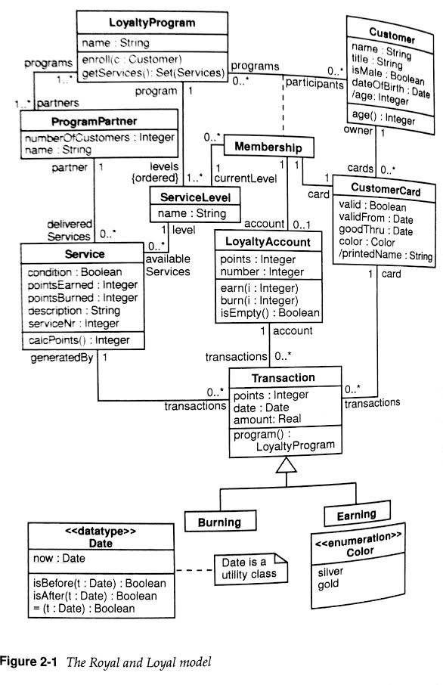

Slide 7
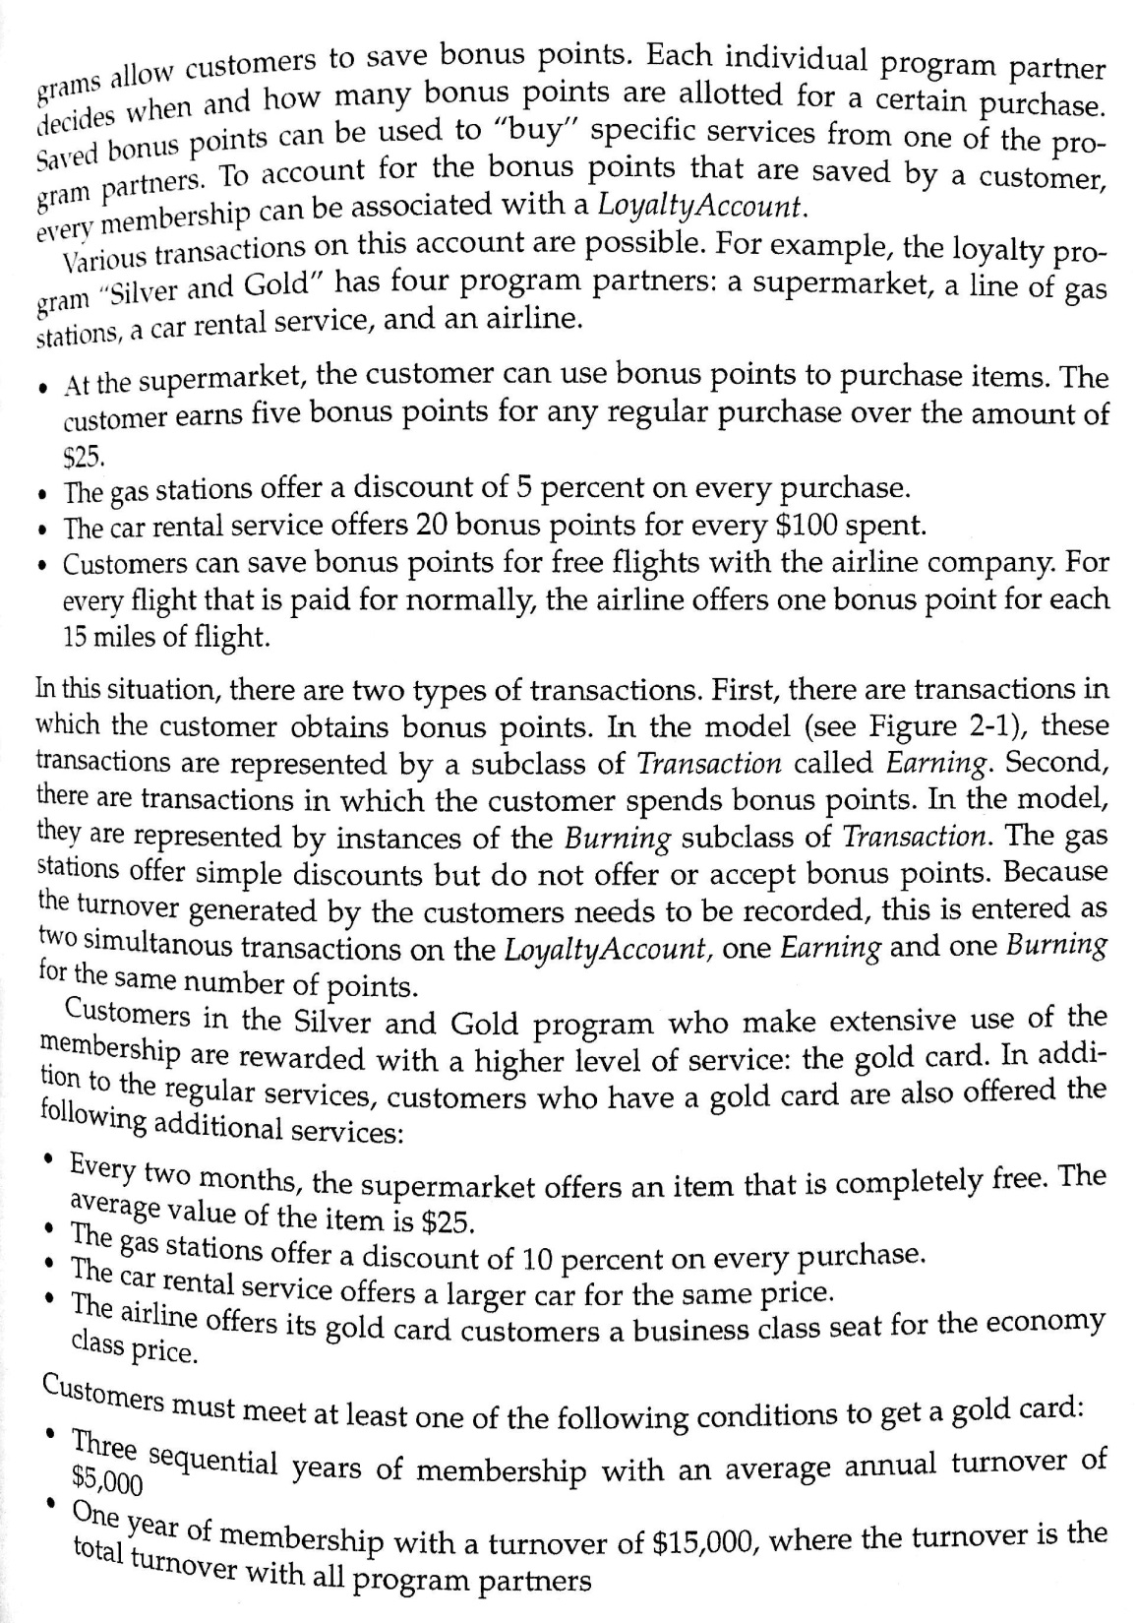

Slide 8
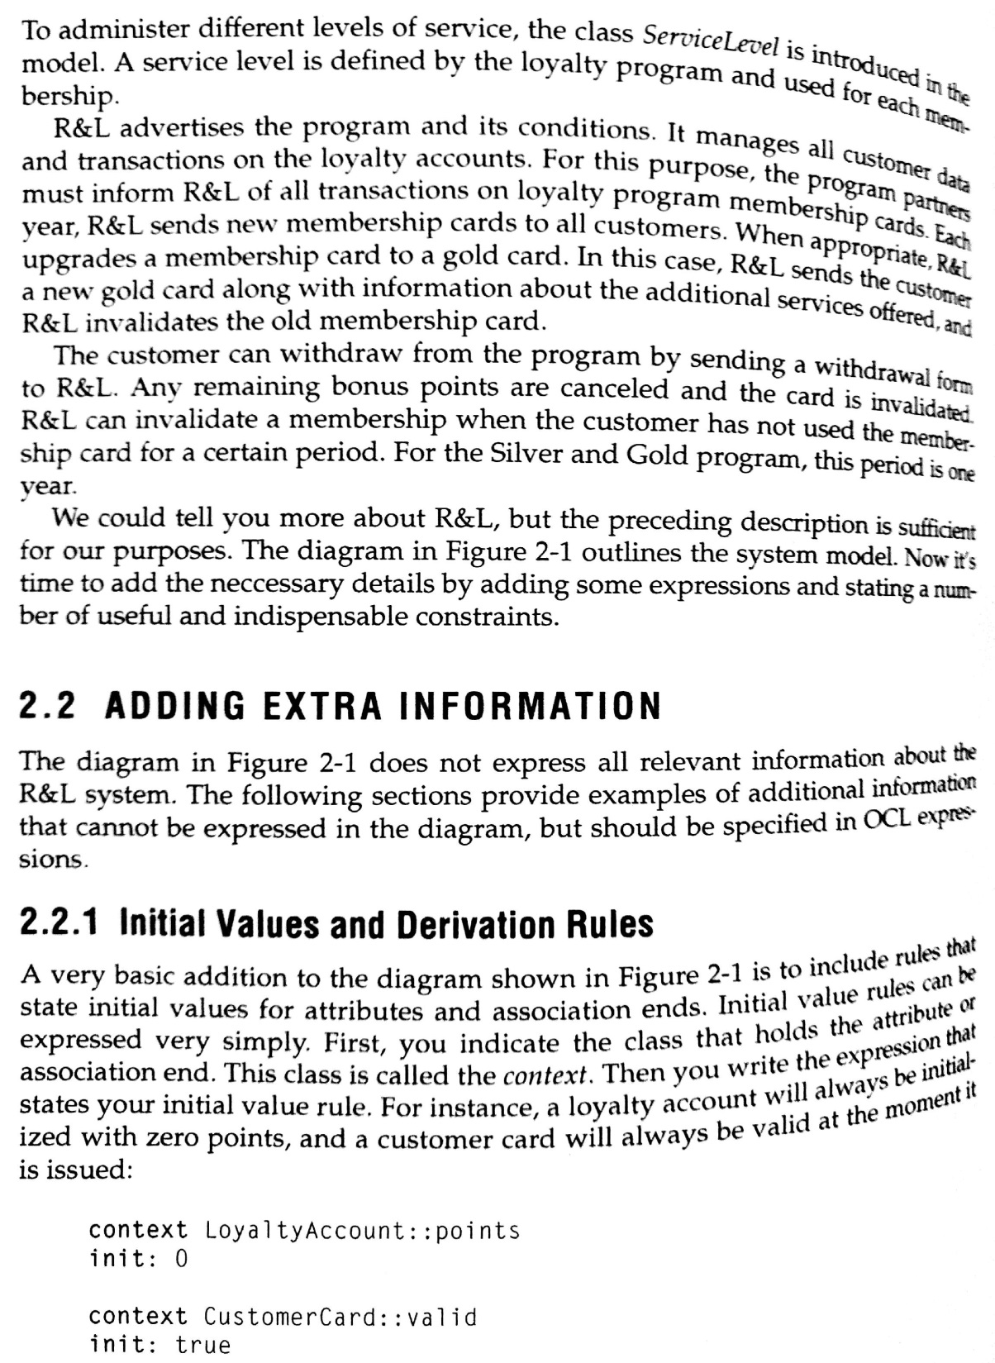

Slide 9
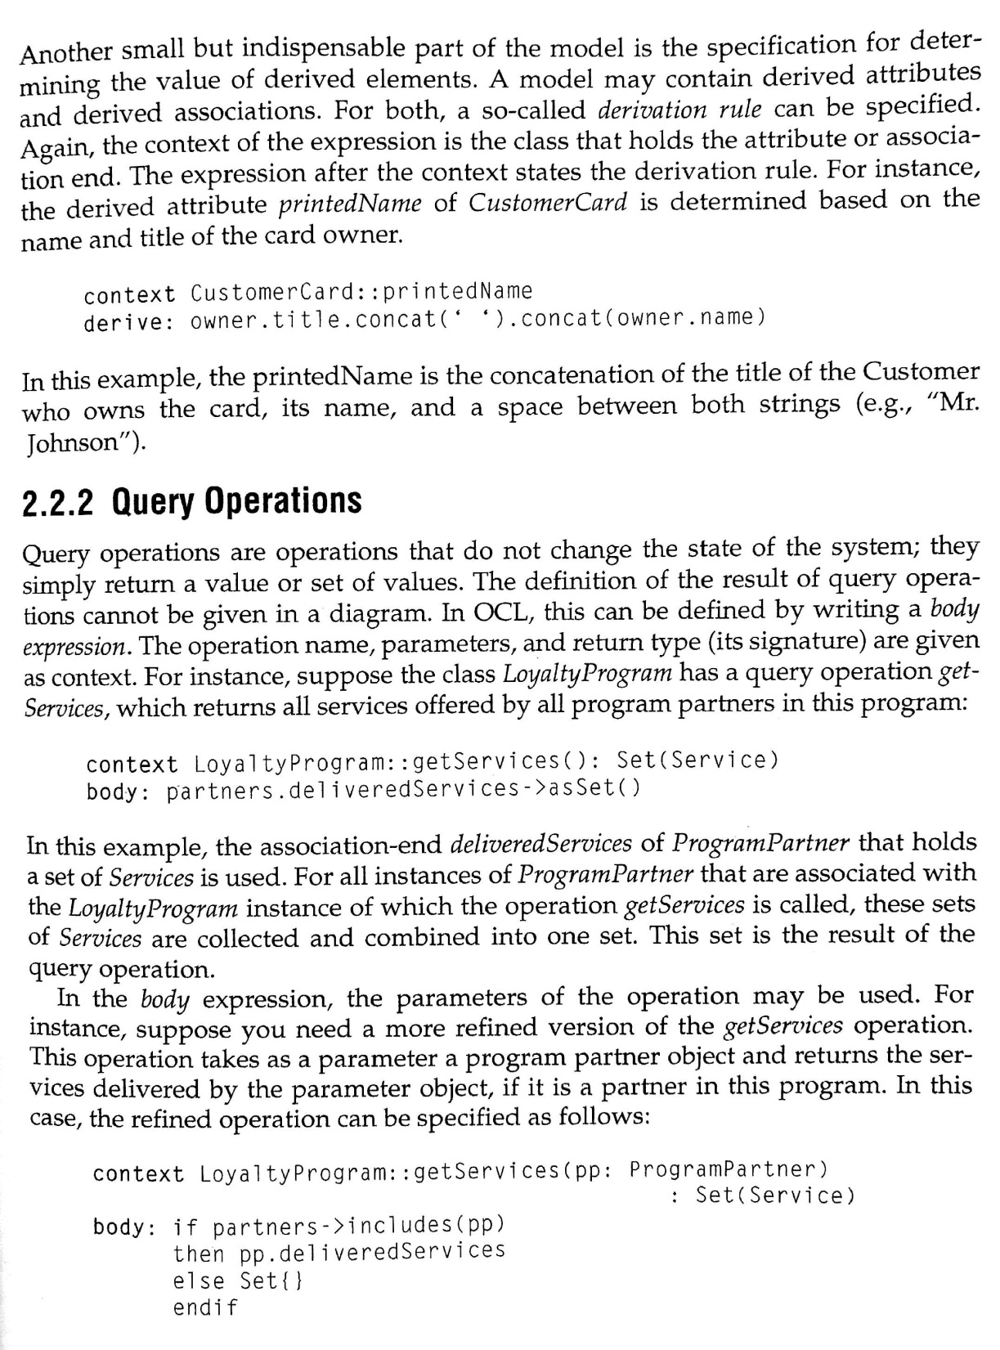

Slide 10
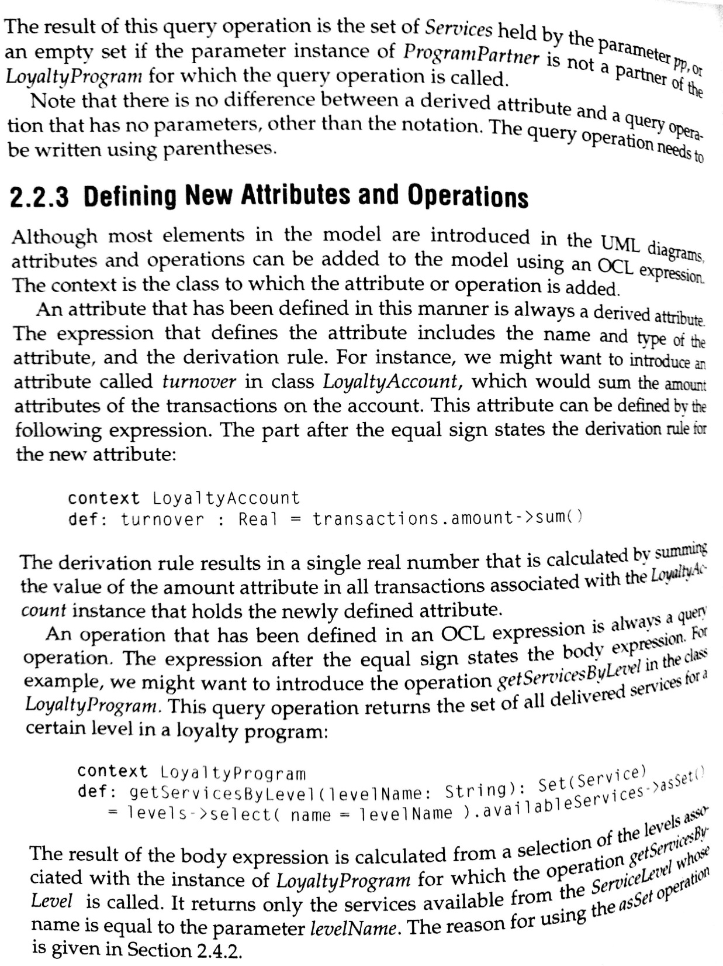

Slide 11
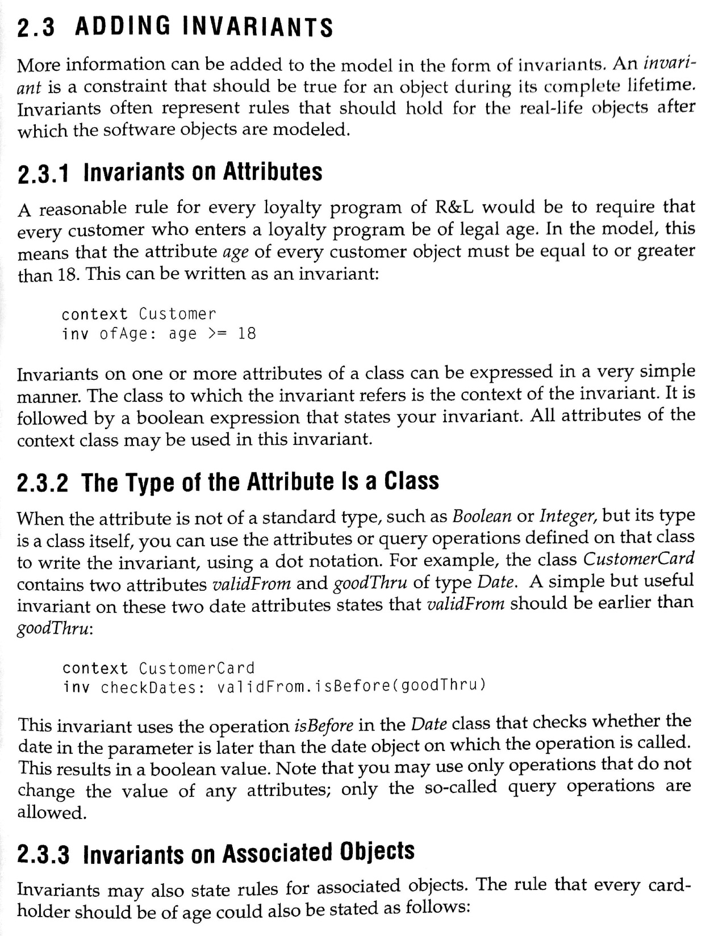

Slide 12
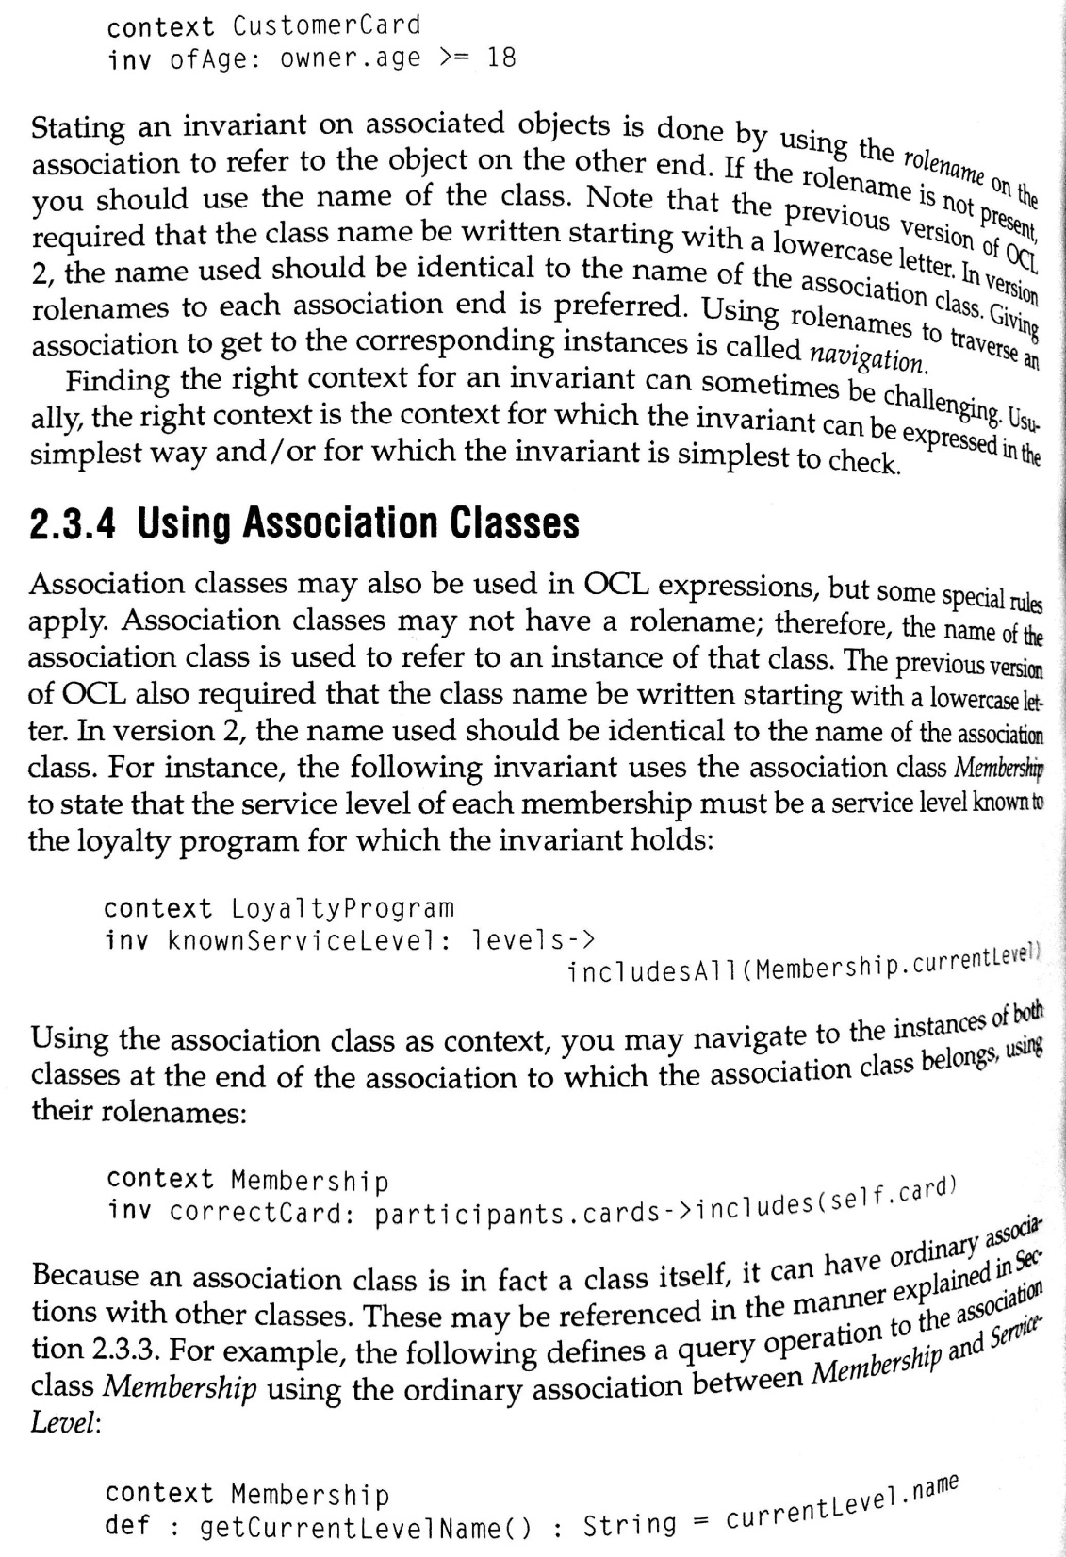

Slide 13
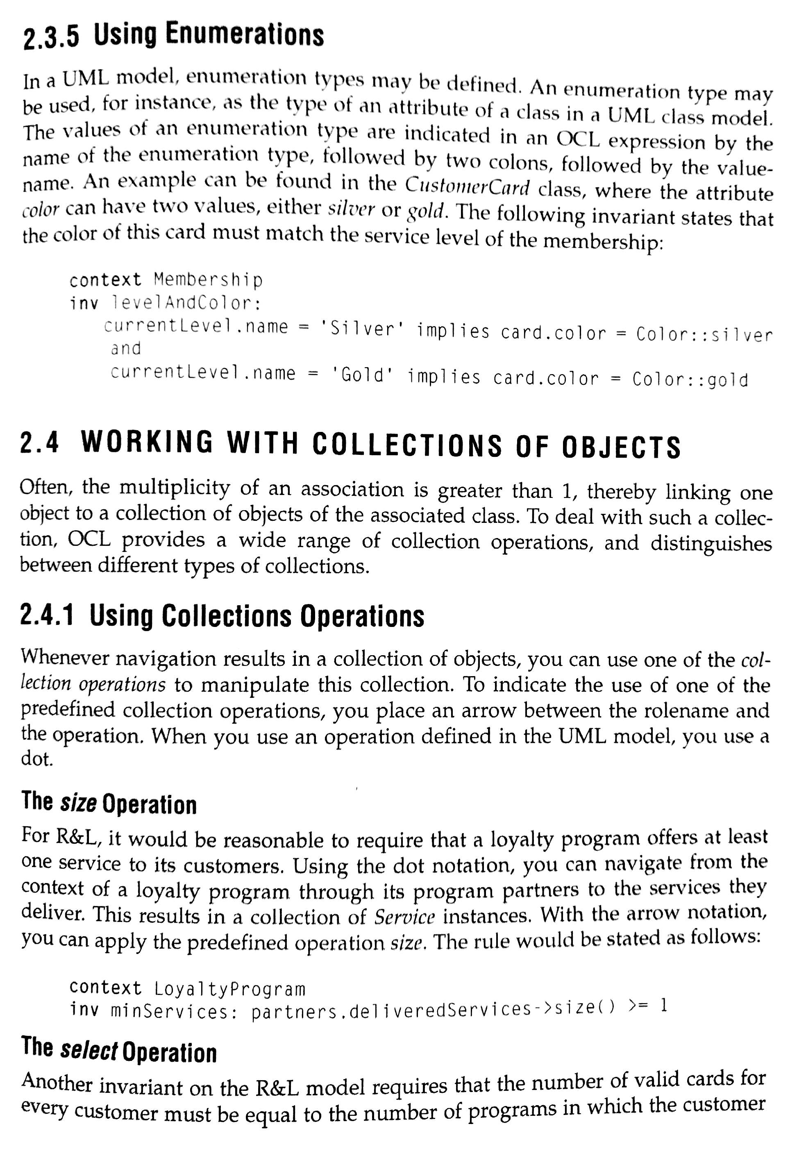

Slide 14
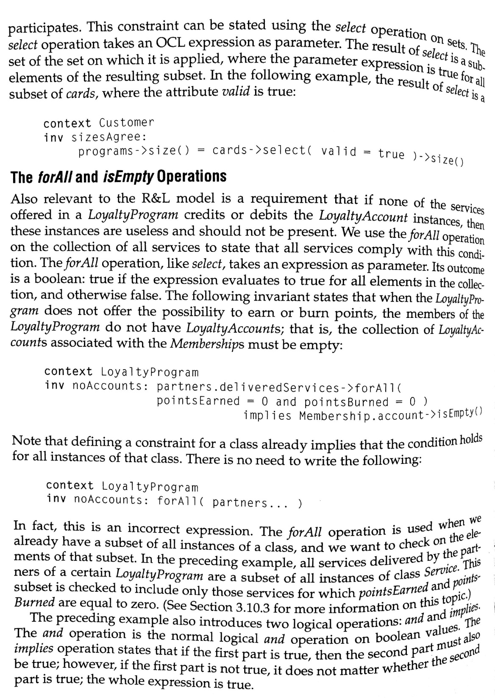

Slide 15
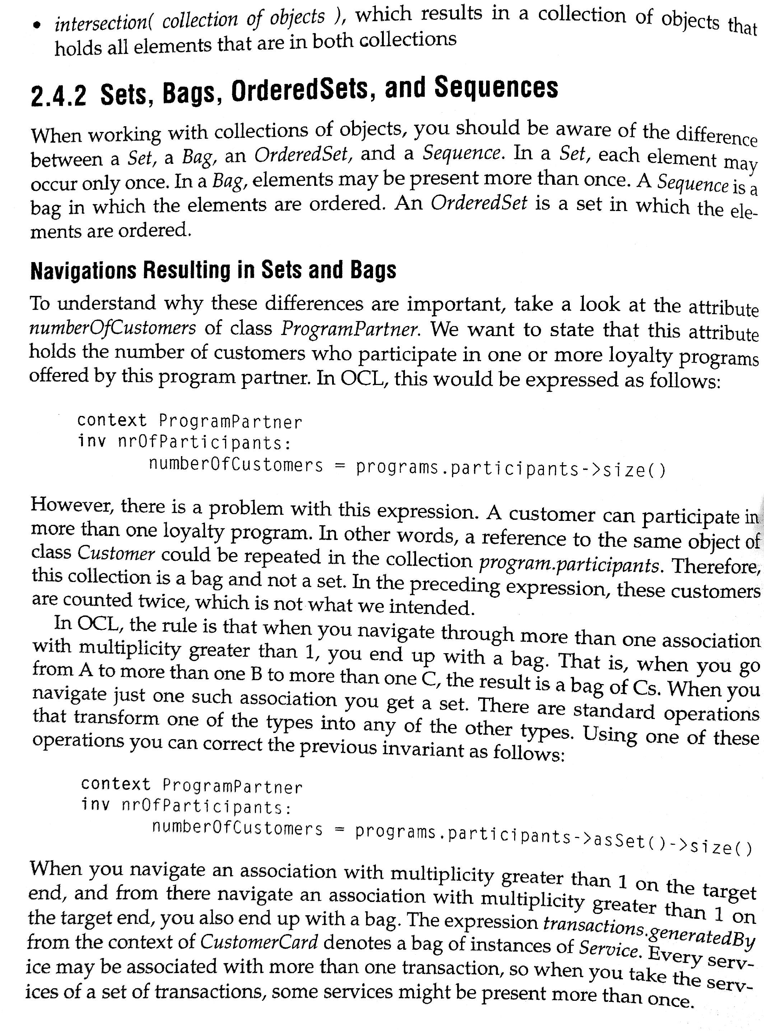
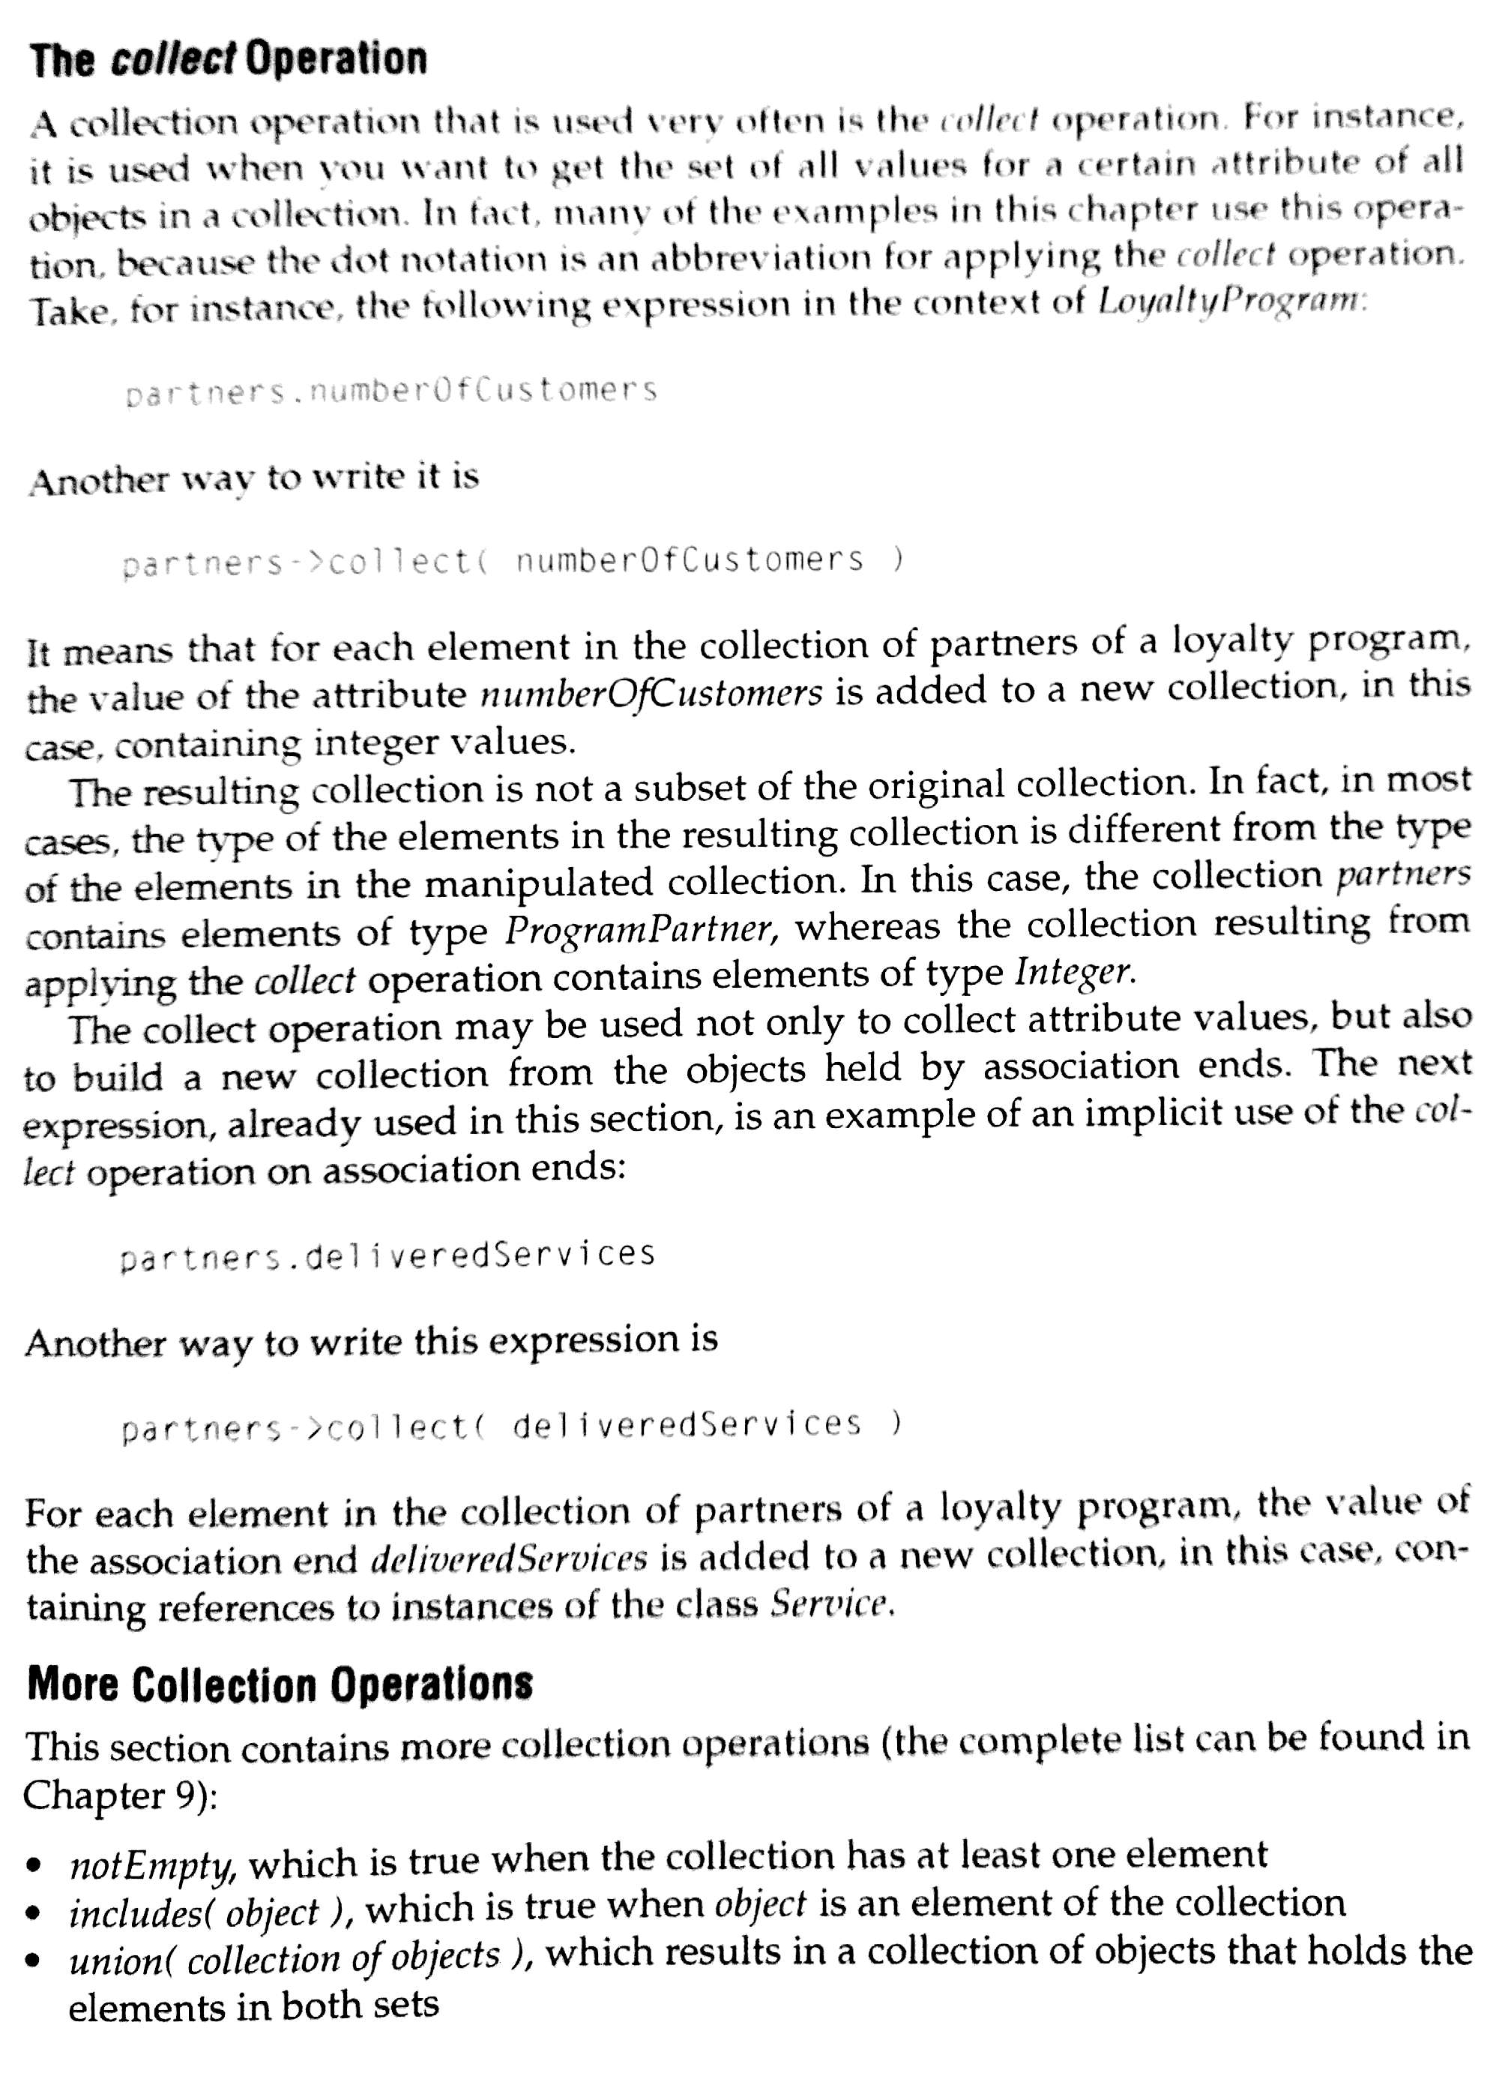

Slide 16
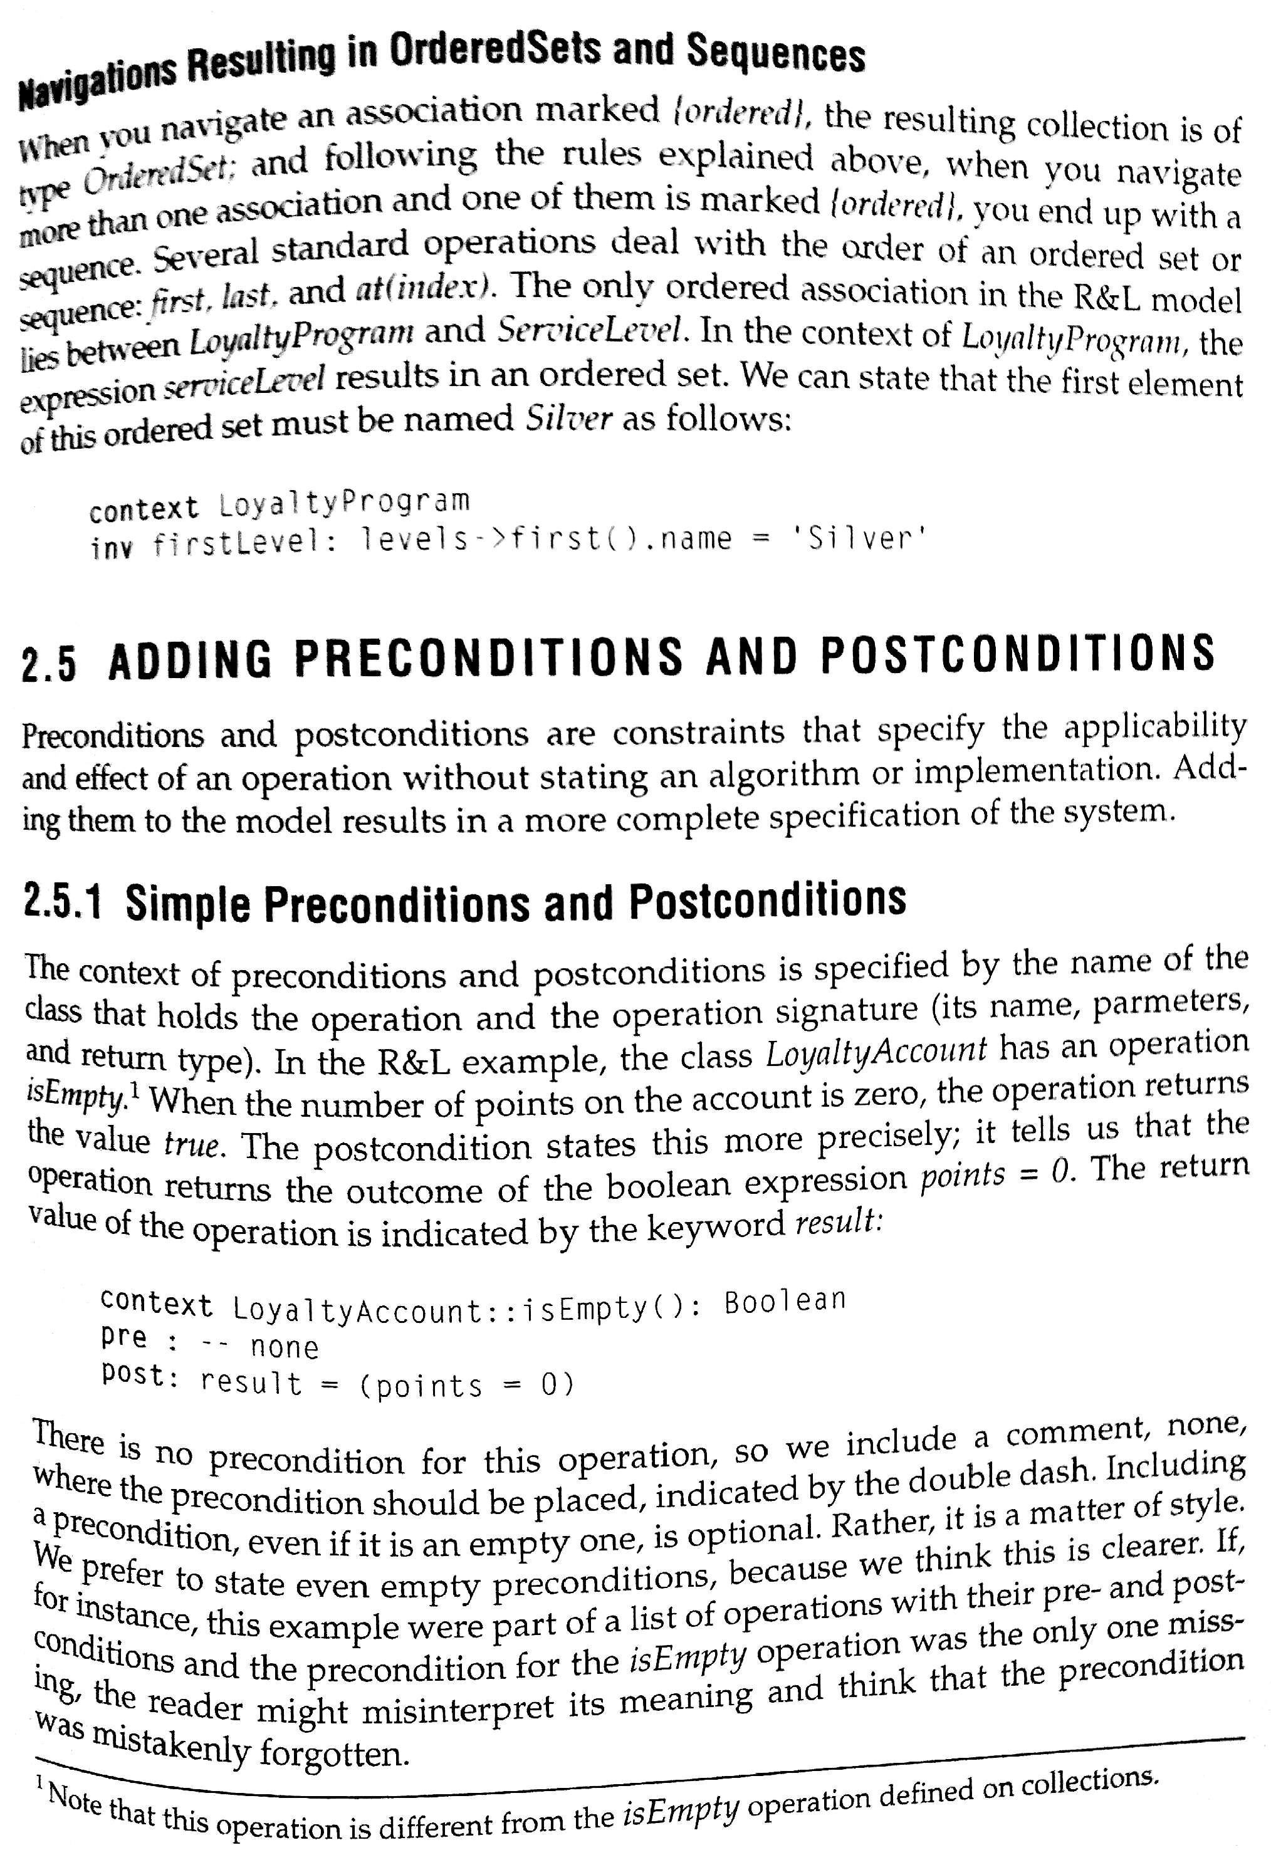

Slide 17
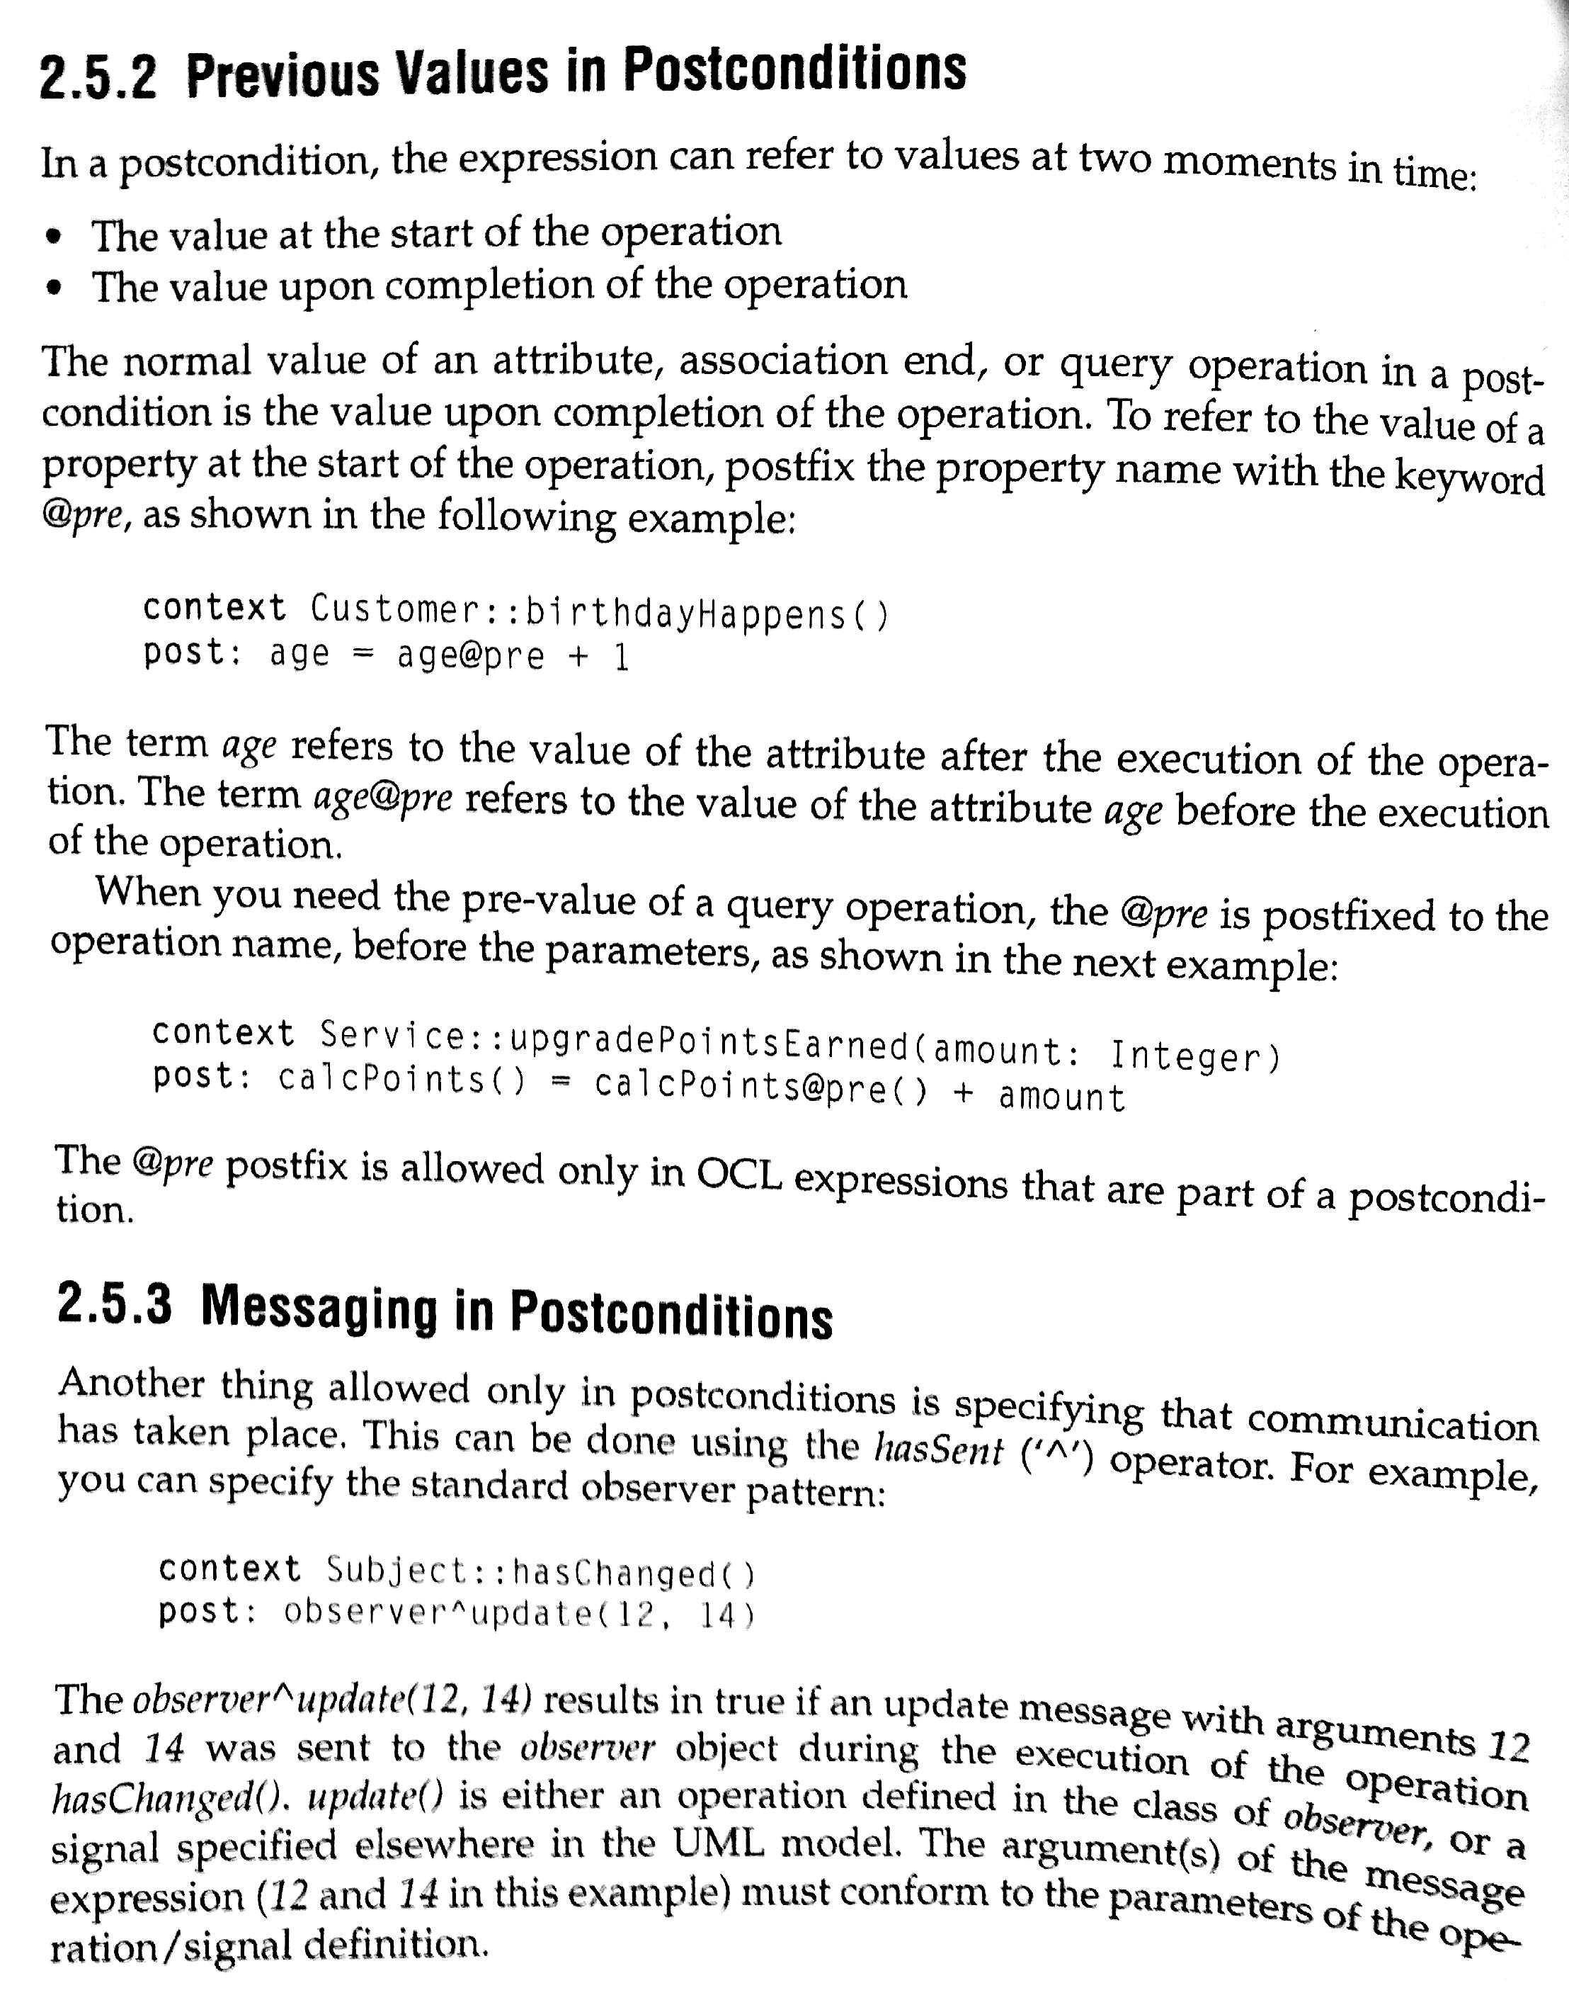

Slide 18
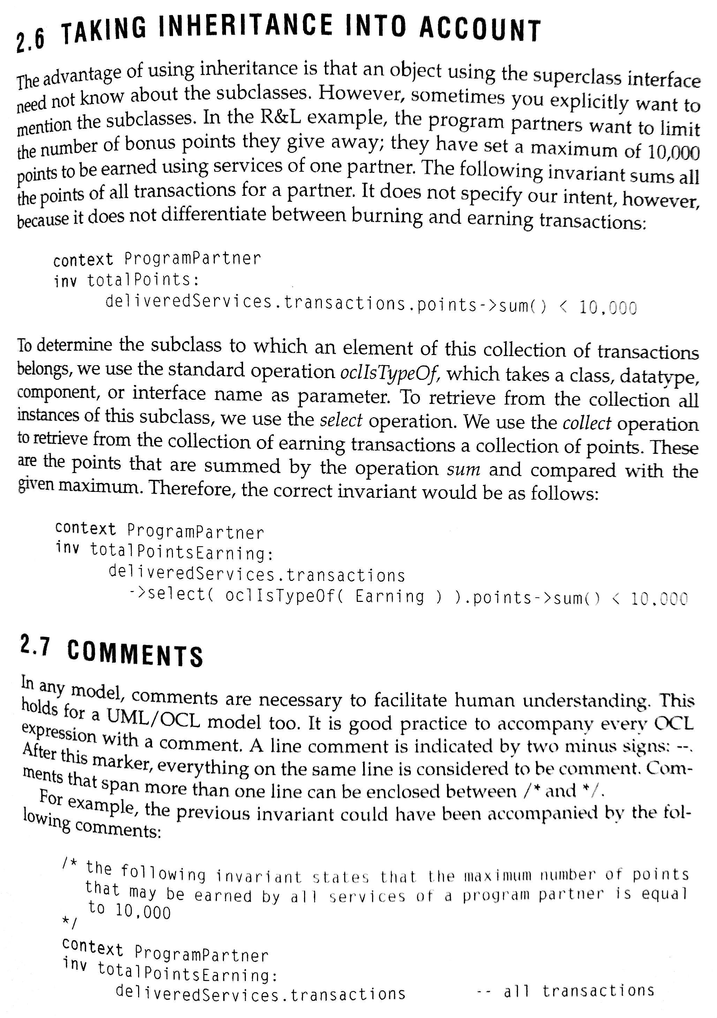

Slide 19
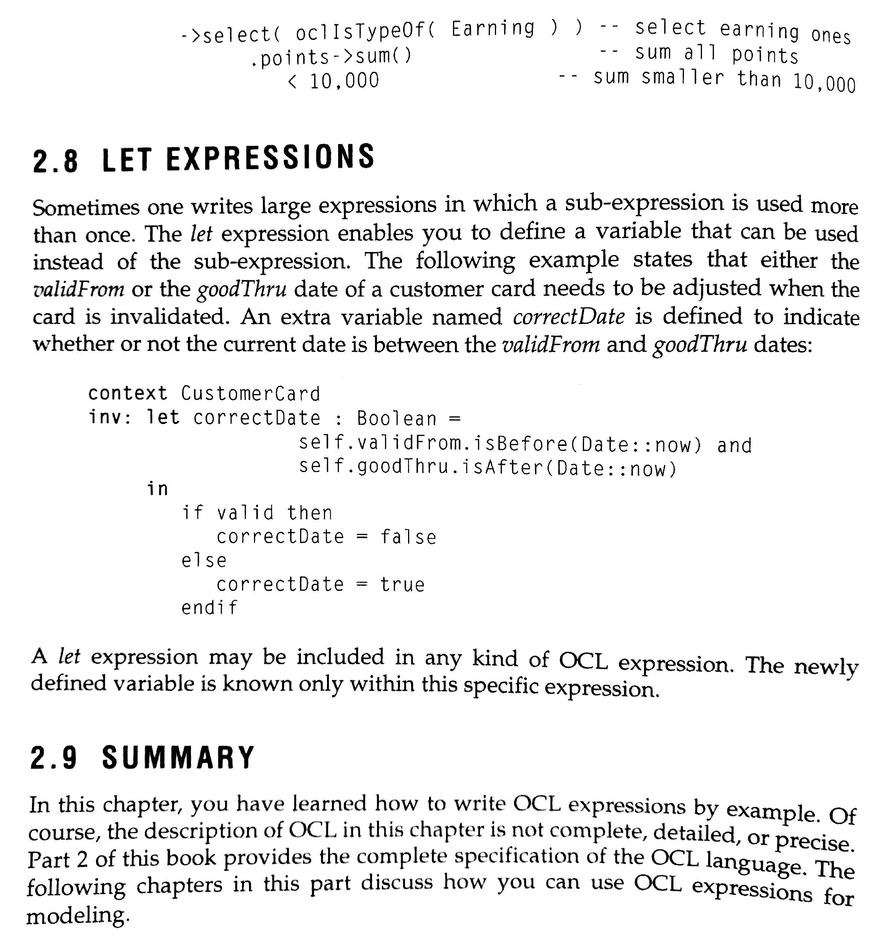

Slide 20
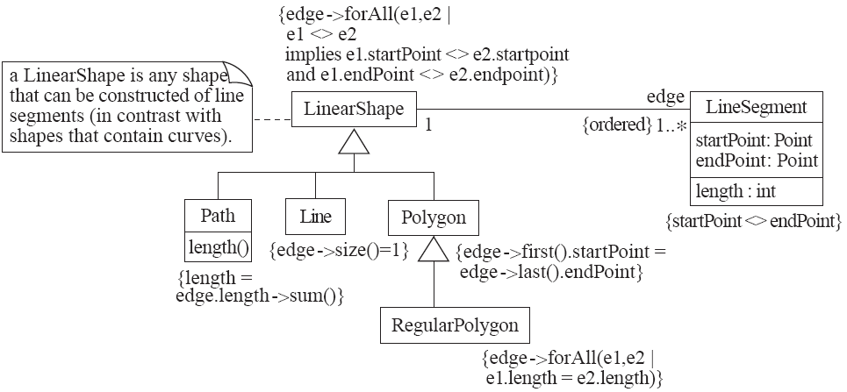
An example: constraints on Polygons

Slide 21
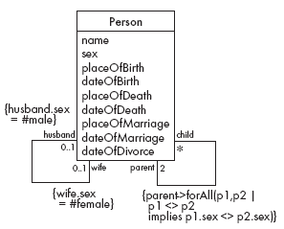
Detailed Example: A Class Diagram for Genealogy
Problems
A person must have two parents
Marriages not properly accounted for

Slide 22
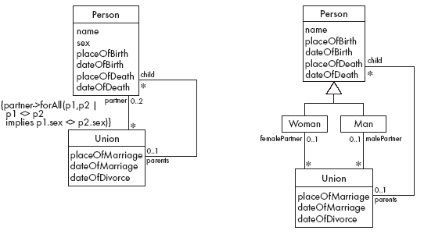
Genealogy example: Possible solutions

Slide 24
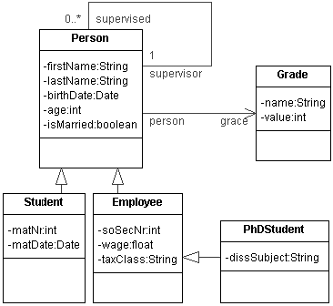
http://dresden-ocl.sourceforge.net/usage/ocl22sql/modelexplanation.html

Slide 25
OCL constraints
The academic grade of a persons supervisor must be greater * than the academic grade of the supervised person. * * context Person inv tudOclInv1: self.supervisor.grade.value > self.grade.value
/* * The academic grade of a students supervisor must be greater * than the academic grade of the supervised person. * * Used patterns: BASIC TYPE, NAVIGATION, CLASS AND ATTRIBUTE */ context Student inv tudOclInv2: self.supervisor.grade.value > self.grade.value

Slide 26
OCL Collection operations
http://atlanmod.emn.fr/atldemo/oclturorial/
The number of elements in the collection self: size()
The information of whether an object is part of a collection: includes()
The information of whether an object isn't part of a collection: excludes()
The number of times that object occurs in the collection self. count()
The information of whether all objects of a given collection are part of a specific collection: includesAll()
The information of whether none of the objects of a given collection are part of a specific collection: excludesAll()
The information if a collection is empty: isEmpty()
The information if a collection is not empty: notEmpty()

Slide 27
SysML http://www.omgsysml.org/INCOSE-2008-OMGSysML-Tutorial-Final-revb.pdf
A graphical modelling language in response to the UML for Systems Engineering RFP developed by the OMG, INCOSE, and AP233a UML Profile that represents a subset of UML 2 with extensions
• Supports the specification, analysis, design, verification, and validation of systems that include hardware, software, data, personnel, procedures, and facilities
• Supports model and data interchange via XML Metadata Interchange (XMI®) and the evolving AP233 standard (in-process)
SysMLisCriticalEnablerforModelDrivenSE

Slide 28
Cont.
It is a visual modeling language that provides Semantics
• It is not a methodology or a tool
SysML is methodology and tool independent
SysML is a specified as a profile (dialect) of the Unified Modeling Language™ (UML™), so SysML is frequently implemented as a plugin for popular UML modeling tools.

Slide 29
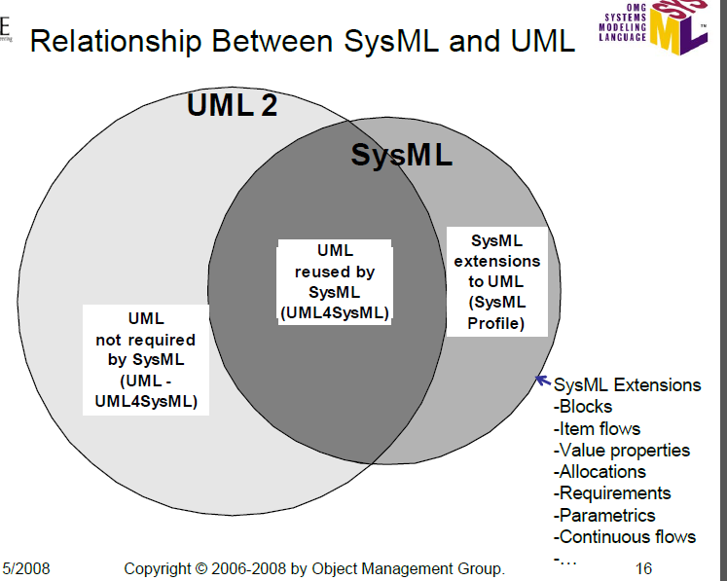

Slide 30
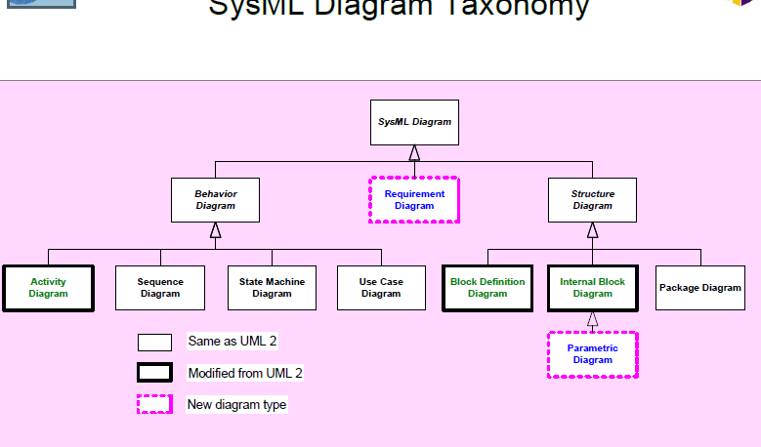

Slide 31
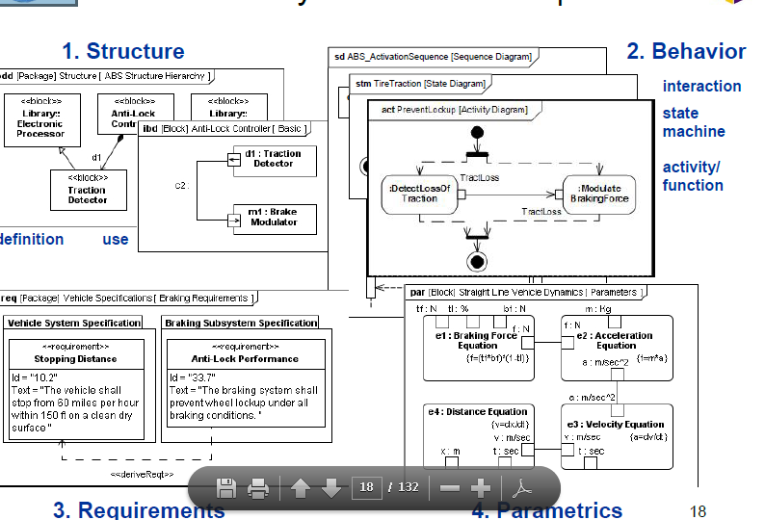

Slide 32
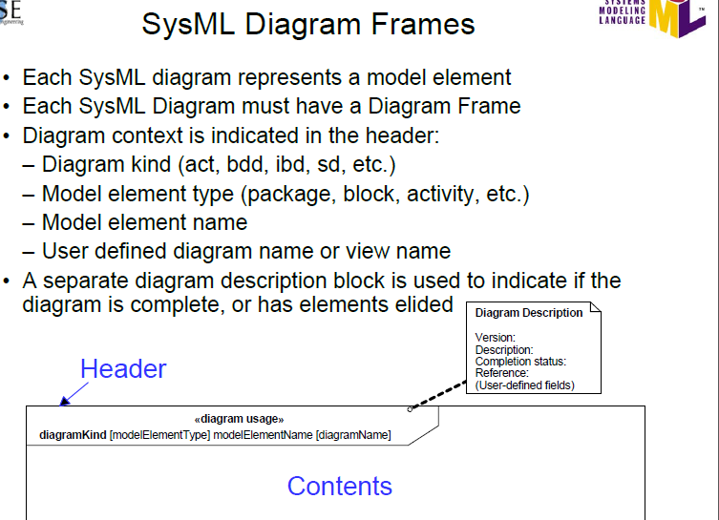

Slide 33
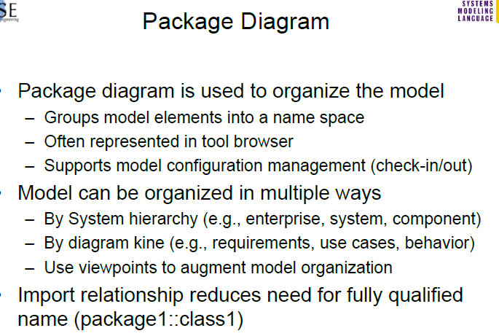

Slide 34
